Slide 1

E-Commerce Review System
01
SANJIL K C (20BCE1855)
02
SAURAV PANDEY (20BCE1749)
CD
03
DEVARINTI DHAPATLA PUNEETH REDDY (20BCE1852)
Content Here
You can simply impress your audience and add a unique zing and appeal to your Presentations. Easy to change colors, photos and Text.

Slide 2

VIDEO LINK
https://drive.google.com/drive/folders/1zcGILNvMpT62_7qaVs-FuKGlPHqPBMrI?usp=sharing

Slide 3
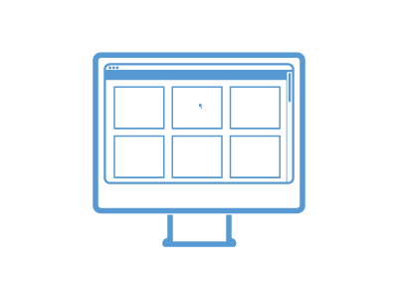
INTRODUCTION
Purpose
The purpose of this application is to predict the fake reviews. Online shopping is the technique where the customers buy the goods directly from the seller, over the internet. So, the customers make the decision of buying the product based on the reviews posted. The fake reviews can mislead the customers on buying the wrong product. The main objective here is to delete the fake reviews and tracks the IP address and also block the user.
Intended Audience and Reading Suggestions
Customer
Developers
Testers
Marketing staff
All Users
Product Scope
This Software System will be a web application which will monitor and delete the fake reviews. In online shopping a user can buy, sell and make reviews on the product. The review plays a vital role in sales of the product. The positive reviews increase the sales of the product and the negative reviews will bring the products market down. So, the spammers will make the fake reviews so as to make the customers to make the wrong decisions about the product. If the fake reviews made by spammers are handled properly the efficiency in online shopping can be increased. The fake reviews can identify and eliminated by the following steps

Slide 4

Overall Description
Product Perspective
01
The product perspective is to increase the consumers, whereas E-Commerce websites need a proper checking system which allows the consumers to buy good products. This system helps the consumers buy providing proper reviews for the products they need.
Product Functions
Users can write the reviews to the products directly. This helps the other customers to find the best product they like. Even after that customer can rate the review. User can directly buy the product without adding it to the cart. It makes the customers to get the product available for cheap on the website. Validate the network parameters and geo-location, Delete the fake reviews and displays the genuine reviews.
02
User Classes and Characteristics
03
Users will be categorized based on the reviews they write. And the user will also get the user incentive to future to post more reviews about the items. This E-commerce site will utilize honest review system. everyone can access the e-commerce website .it is assumed that user is familiar enough with a computer to operate the browser. And also, user know the terms like login, register and order.

Slide 5
Overall Description
Operating Environment
04
Internet Explorer and Mozilla Firefox is the environment in which the software will operate. This will be operated with windows10 operating system. These websites will be working properly on web server and database system with the help of internet connection which allows the system to communicate with the clients.
Design and Implementation Constraints
The monitoring fake review model shall be a stand-alone system running in a Windows environment. This software will be available all the day and night and as it is a website. user do not require any memory to save the data. Assistive technology is used in this website. User can access the website with English, Tamil and Hindi languages. user can directly communicate with the customer support care. And also, only the basic information will be collected from the user like full name, age, mobile number and address.
05
User Documentation
06
The product will include user manual. The user manual will also include the product overview, and complete configuration of the use software, technical details, backup procedure and contact information which will also include email address and contact number. And also, online help is provided.

Slide 6
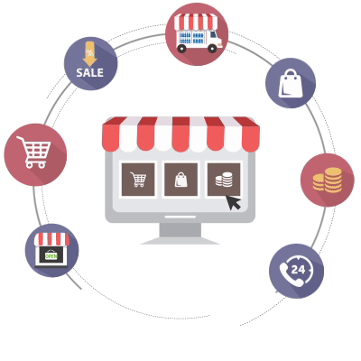
External Interface Requirements
Hardware Interfaces
Processor: Intel Pentium.
Ram: 1 GB or more.
Hard disk: Recommended for the primary partition.
User Interfaces
Software Interfaces
A user interface, commonly referred to as a “UI,” is the user-facing design of a webpage or application. User-friendly UI is important for ecommerce merchants to provide intuitive navigation and a pleasant shopping experience for customers. The user interface element that allows a User to input text to the system.
XAMPP
Apache tomcat
MYSQL
Internet Connectivity.

Slide 7
System Features
Description and Priority
Stimulus/Response Sequences
Functional Requirement

Slide 8
Other Non-functional Requirements
01
Safety Requirements
Safety is very important, but so is our physical safety and delivery of our products. If our ecommerce logistics and supply chain isn’t secured, then we can’t guarantee the safe and fast delivery of our products to our customers, which is bad for business. In order to run a successful e-commerce business, we must ensure that both our cyber and physical security measures are in order
Pick strong password
Don’t use public wi-fi
Guard your personal information
Track your product
Report the scammers
E-COMMERCE
REVIEW SYSTEM
02
Security Requirements
Our databases will be encrypted using RSA cryptosystems making it more secure than conventional database security systems. Input: Databases. Processing: Encrypt using RSA cryptosystem. Output: Encrypted Database
Software Quality Attributes
03
The software quality attributes in our product involves adaptability (i.e., the software works on any platforms which is independent). The software maintains correctness, (i.e., producing accurate results) flexibility, maintainability (cost can be maintained efficiently), portability, reusability (i.e., software code can be reused n number of times), robustness (i.e., preventing from malwares), testability and afford usability.

Slide 9


Other Requirements
E-COMMERCE
REVIEW
SYSTEM
Taxes
Terms of Service
Privacy Policy
Return and exchange policy
Shipping Policy

Slide 10
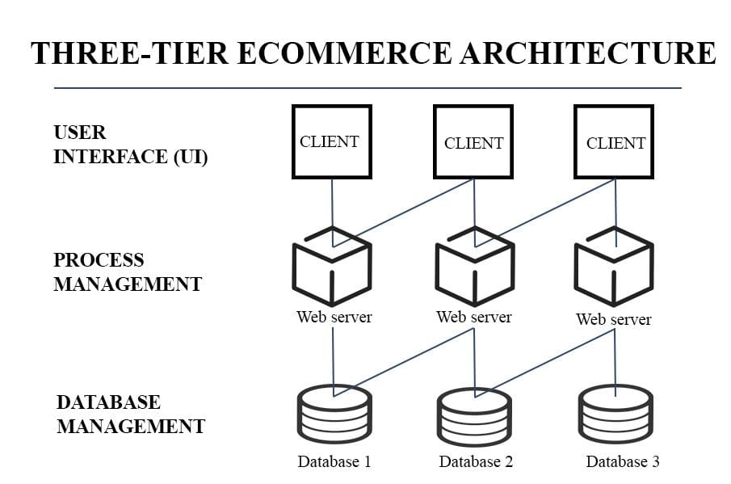
ARCHITECTURE DIAGRAM

Slide 11
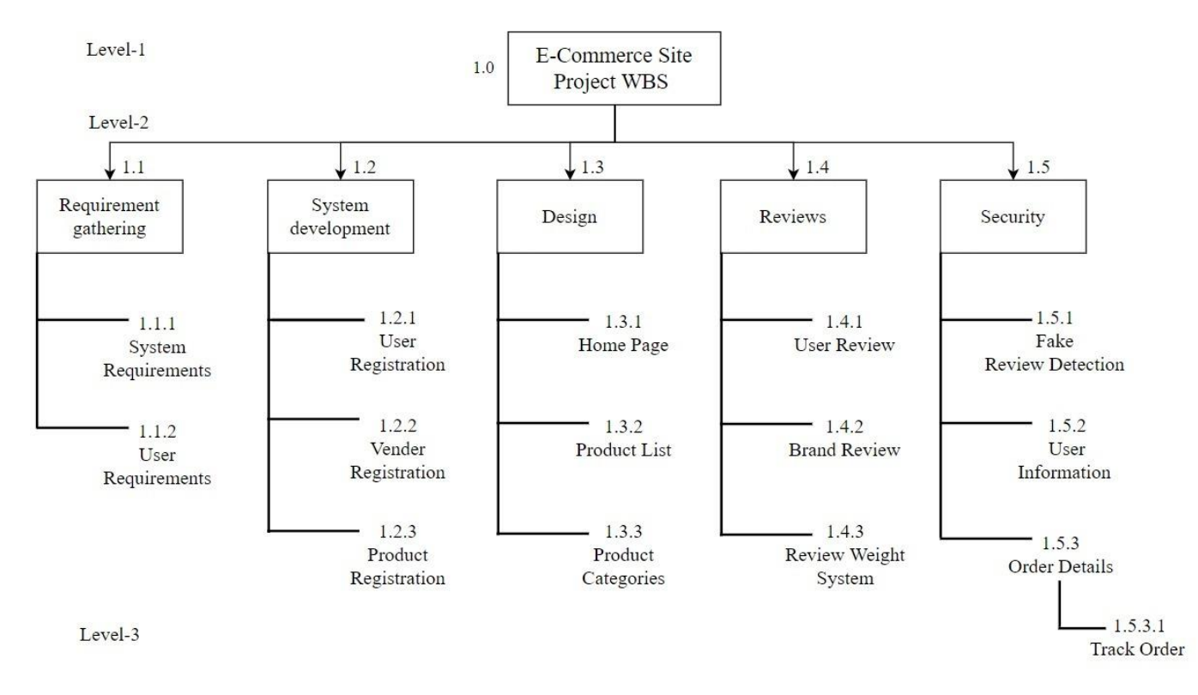
WORK BREAKDOWN STRUCTURE

Slide 12
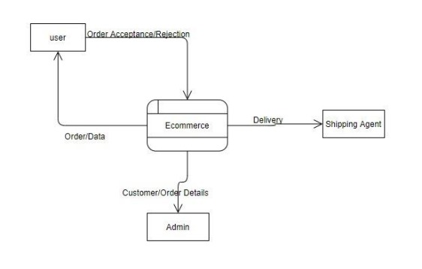
DATA FLOW DIAGRAM
LEVEL 0

Slide 13
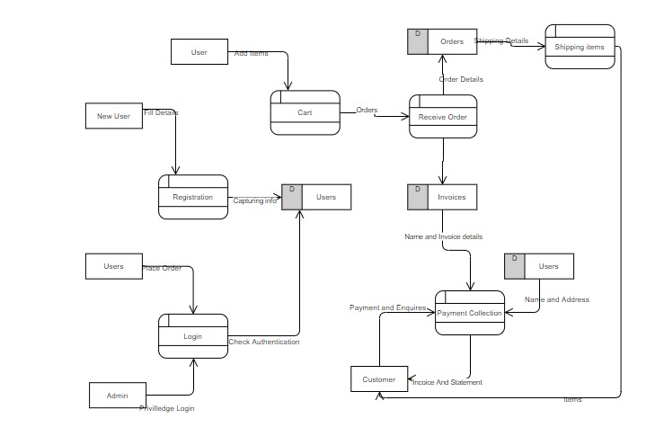
DATA FLOW DIAGRAM
LEVEL 1

Slide 14
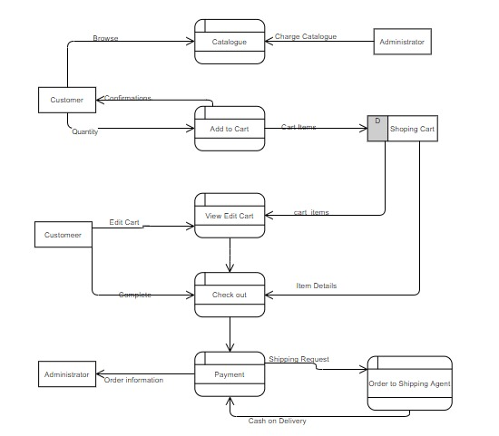
DATA FLOW DIAGRAM
LEVEL 2

Slide 15
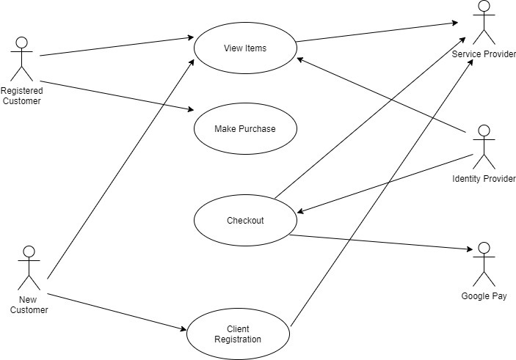
USE CASE DIAGRAM
01

Slide 16
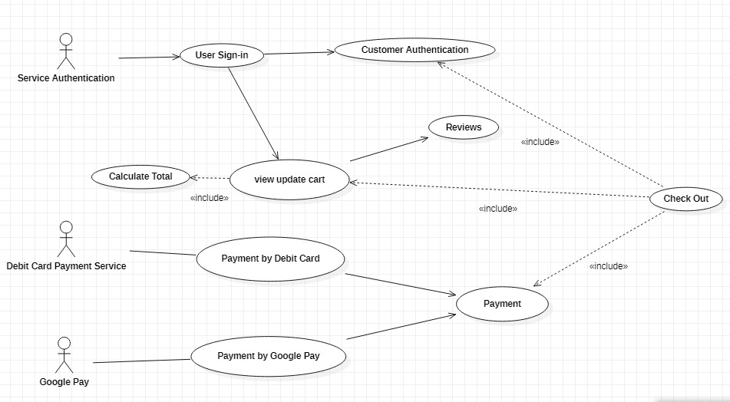
USE CASE DIAGRAM
02

Slide 17
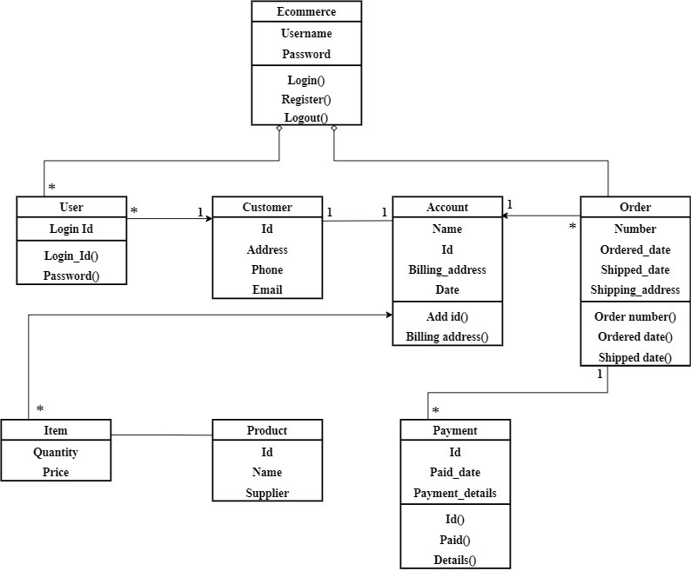
CLASS DIAGRAM

Slide 18
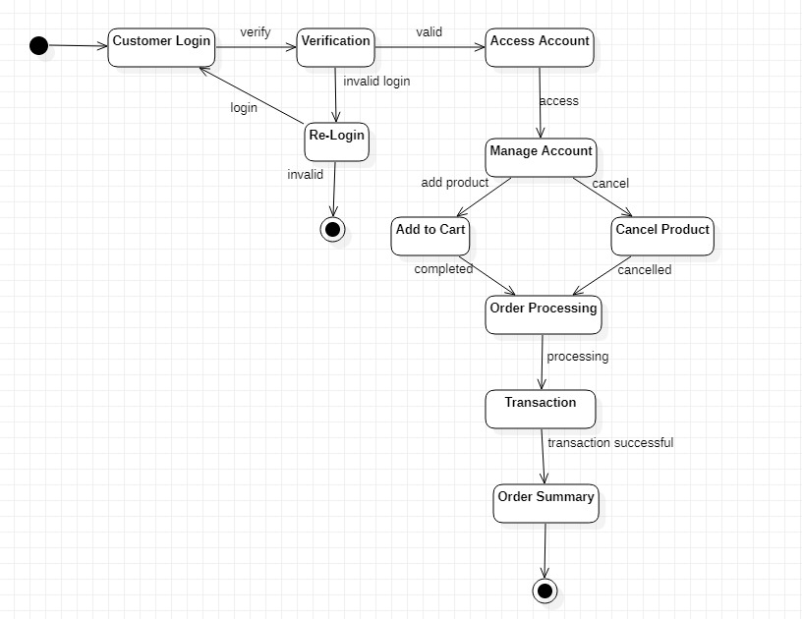
STATE DIAGRAM

Slide 19
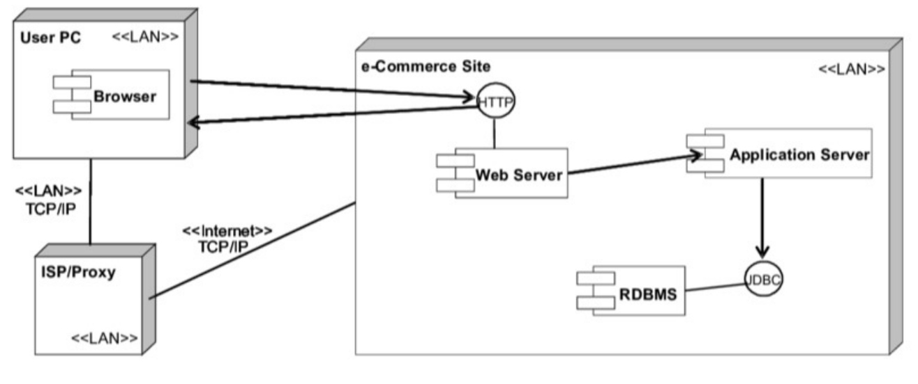
DEPLOYMENT DIAGRAM

Slide 20

CONCLUSION
E-COMMERCE
There are many several attempts are made for fake review detection till today. In this we performed a general work to detect fake reviews. Now a day’s technology is growing day by day and there are so many websites and application available in the online market by which they sell their product. Every product contains millions of reviews and on basis of these reviews' user buy the product most of the time. There are some organizations which post fake reviews on genuine product and user gets stuck.
Our software will help the user to find for the for the original products. Our software will do analysis and then if any fake review is found from any IP address continuously then admin user can block that particular IP address. It will also send mail to the user regarding blocked IP address. In this way it monitors the fake review made on any product In the website. And the user can be confident about the products available on that application and reviews.

Slide 21


